Slide 1
Hospital management system
Group Members
Mohsin Quddus 17-NTU-1090
Nouman Azeem 17-NTU-1098
Asma Abid 17-NTU-1075
Umaima khalid 17-NTU-1109
Submitted to Sir

Slide 2
About Project
Hospital management system as the name indicates will be used for managing hospital records will be used for various purposes.
So this system has been enabled with validation data checkup while entering the data and before saving it to the particular file. Hospital will also able to check their data and modify their basic information as per their requirements.

Slide 3
File Handling
File handling has been used for the effective implementation of all the typical features of this project. The key features of hospital record management System are:
Input record:
This feature creates a new hospital record containing his . Doctor Number , Name ,Phone Number , speciality , Salary , Date of Joining and etc. For this purpose We Use Different Type of Functions And Members in Class.

Slide 4
Display Records :
By using this program user can able to show all Doctors And Patient record. By using this user can display the .Doctor Number , Name ,Phone Number , speciality , Salary , Date of Joining ,Department and etc. For this purpose we use Display All Function in Class Prototype And Whole function outside the class.

Slide 5
Search record :
This feature is use for display the specific record from whole entered record. User can search record through Doctor name , City and phone number If no record is found in file, it displays the message “Record not found”

Slide 6
Modify record/Update Record:
In record management system project in C++, this feature is used to edit the particular record . For this, search record by first name of doctor/ paitient name . For this purpose we have used “void update ();” function in class. If no record of student is found in file, it displays the message “Record not found”.

Slide 7
Delete record:
This feature deletes the record of a particular student; it first of all asks for the first name of the doctor / patient name . of the doctor or patient whose record is to be deleted. After entered roll no. in will delete record.

Slide 8
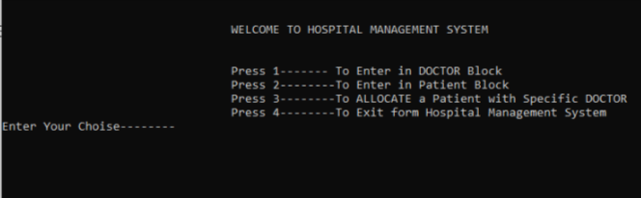
Main Menu
This is the main Block of the Hospital management system
We can go into 3 blocks from here and close the whole program
From 1 we go enter in the doctor block
From 2 we can enter in the patient block
From 3 we can Allocate the patient to a doctor
From 4 we can close this Whole program

Slide 9
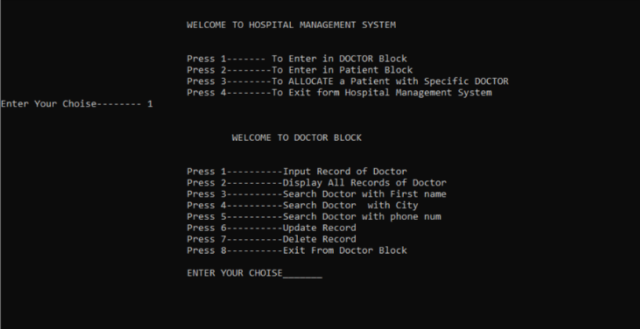
This is Doctor block
In which we can
Input Record
Display all Data base
Search with doctor first name , city and phone number.
We also update the record
And delete the record
And from 8 we can go-back to main menu

Slide 10
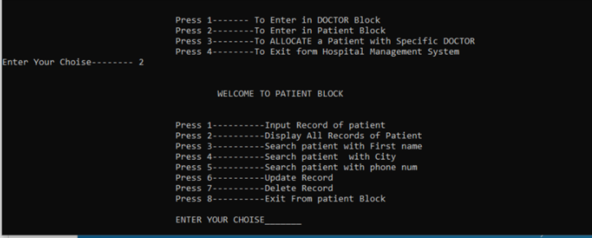
This is Patient block
In which we can
Input record
Display all records
Search with patient name , city and phone number as in doctor block
We can also update a record
And delete it
From 8 we can go-back to main menu

Slide 11
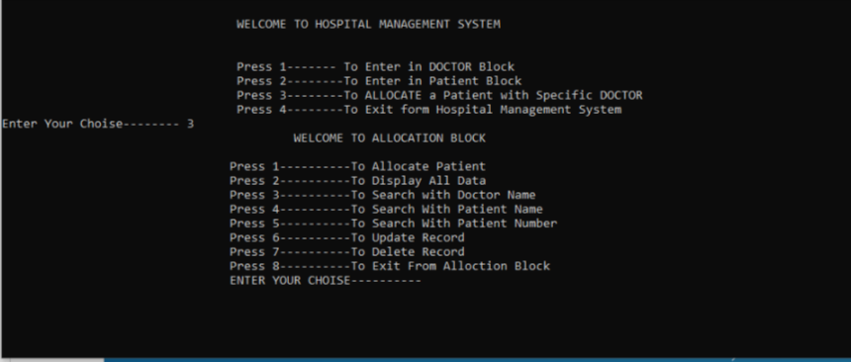
This Allocation Block
In which we can
Allocate a patient
Display all allocations
Search with doctor name , patient name and with patient serial number
We can also update record
And delete the record
And from 8 key we can go-back to main menu

Slide 12
Thanks The End

